Slide 1
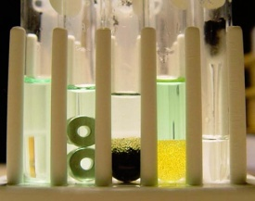
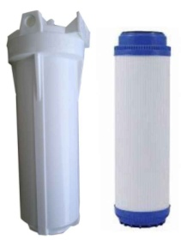
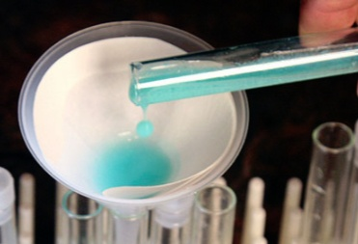
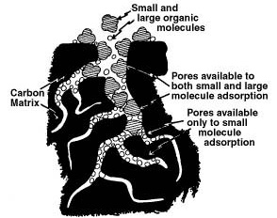
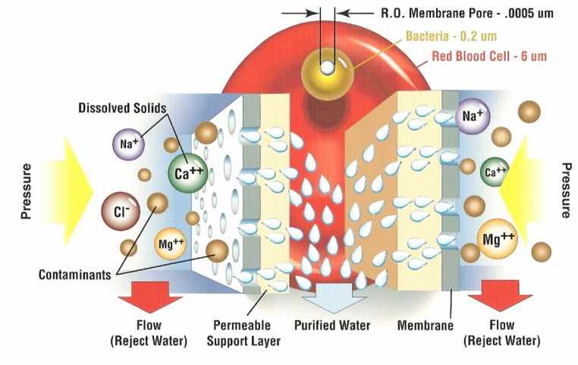
Lab 4: H₂O Purification & Conservation
Mechanical filters: These work like a screen. The holes are big enough to let water through but small enough to block contaminates like debris or even bacteria.
Cartridge filter & housing
Paper filter
Flocculation & sedimentation: Water with a lot of suspended particles is usually treated so that most of those particles will form clumps (flocs) which will then settle out by gravity (sedimentation). Then the water is filtered.
Filters are often based on size of particles they can trap. Sizes are in μm (μm=micrometer=millionth of a meter) and nm (nanometer=billionth of a meter). The second row shows examples of what contaminants can be trapped. The third row shows what these filters are made of.
Particle filtration | Microfiltration | Ultrafiltration | Nanofiltration | Reverse Osmosis
1000 μm – 10 μm | 10 μm – 0.1 μm | 0.1μm – 0.01 μm | 0.01μm – 1 nm | 1 nm – 0.1 nm
Sand, pollen, yeast, fibers, bug parts | Red blood cells, large bacteria, small particles, asbestos | Small bacteria, large viruses, large molecules | Small viruses & molecules, large ions, heavy metal ions, dyes | Ions with +1 or -1 charge. Allows just water to pass.
Paper, cloth, sponges, diatoms | Tightly packed fibers | Membrane | Membrane | Membrane made of protein-like material
From microfiltration to reverse osmosis, these require pressure to force water through the very small pores.
Because these can remove dangerous microbes, they are also referred to
as non-chemical or cold (no heat) sterilization.
Activated charcoal
Reverse Osmosis
Adsorption: This is where contaminants adhere to the surface of the filter medium. A common example is activated charcoal. It removes contaminants that will stick (adhere or be adsorbed) to the surface of its many pores and crevasses.

Slide 2
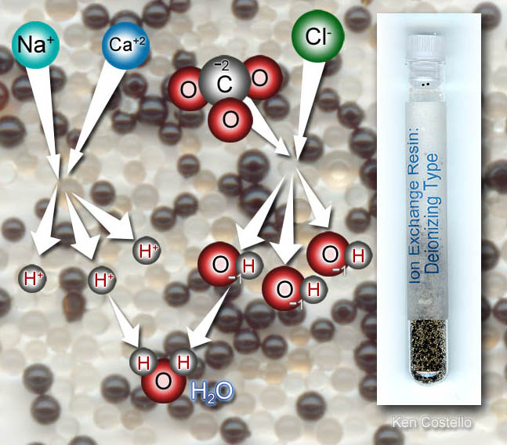
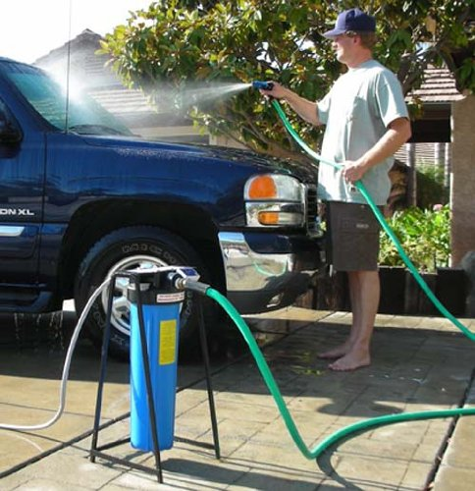
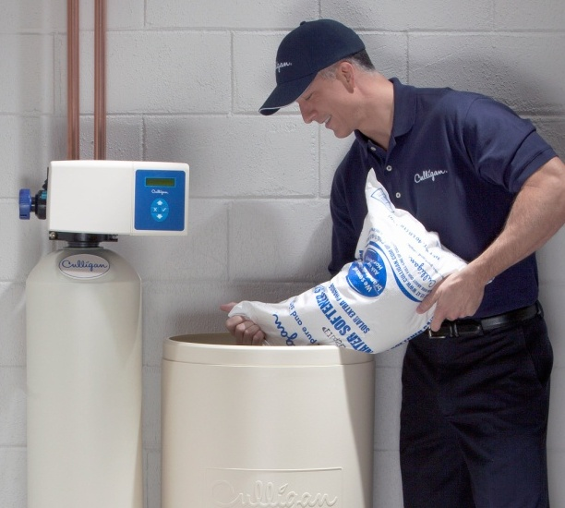
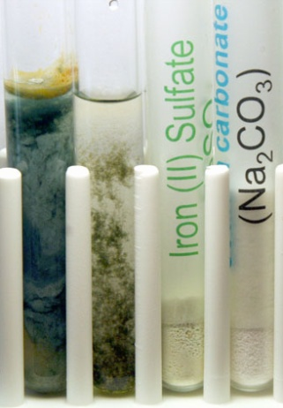
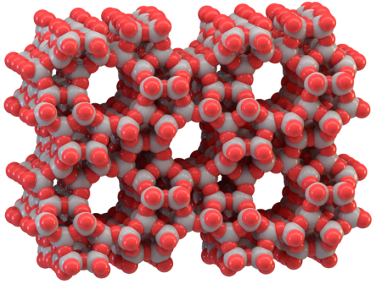
Lab 4: H₂O Purification & Conservation: Ion Exchange & Replacement
Ion Exchange: Sometimes instead of trapping dissolved toxic (or unwanted) metal ions, it’s easier to swap them with a safer ion. In other words, you do an ion exchange. That is accomplished by having some material that is coated (or populated) with safer ions, and when the undesired ions come by, they take the place of the preferred ions.
Spot free water: We know if we wash our car with regular tap water, there will be water spots due to dissolved salts in the water. The ion exchange filter here traps (+ & -) ions and replaces those ions with H⁺ & OH⁻ ions, which instantly combine to make water (H₂O). So no more water spots on a washed car.
In the blue cartridge on the right are two kinds of plastic beads. One of the beads has H⁺ ions attached to molecules that make the beads. Those beads will trap positive metal ions (such as Na⁺ and Ca²⁺) and replace them with H⁺ ions. The other beads have OH⁻ ions bound to the molecules it is made of. Negative ions like Cl⁻ (chloride) or CO₃²⁻ (carbonate) will be trapped and OH- ions will be released. The H⁺ and OH⁻ ions will combine to make pure water (H₂O).
Water Softener
Water softener: A water softener also uses ion exchange technology. In the left tank are beads that have sodium ions (Na+) loosely bound to the beads. When tap water passes over the beads, metal ions such as calcium, magnesium, copper, or iron will exchange places with the sodium ions. Now the tap water only has sodium ions. Since sodium ions do not interfere with soap, water with only sodium ions is considered “soft” water. Over time the beads will have released all of their sodium ions and be filled up with ions like calcium. That’s where the tank on the right comes in. It is filled with table salt (NaCl/sodium chloride) and water. The high concentration of sodium ions will knock loose the calcium & other ions, and the beads will once again be attached to sodium ions, so water softening can be repeated.
Ion
Exchange
Tank
Brine Tank
Double Replacement Reactions: These reactions can replace toxic metal ions with safer metal ions. For example, washing soda
Zeolite: Instead of plastic beads, water softeners (and other ion exchange equipment) may use a mineral called zeolite. Its silicon, aluminum, and oxygen atoms are arranged so that there are pores (holes) in their crystals. These holes loosely
is sodium carbonate (Na₂CO₃). The carbonate ion (CO₃²⁻) will bond with toxic metal ions like iron, mercury, or lead to form solid particles which will sink to the bottom of the container to be removed or filtered out.
bind to water and ions. If soaked in salt (NaCl) water, they can act the same way as the beads do in water softeners. Zeolite saturated with NaCl is added to laundry detergent so as to exchange sodium ions with calcium ions.
Zeolite crystal
Na₂CO_{3(aq)} + Fe²⁺_{(aq)} → 2Na⁺_{(aq)} + FeCO_{3(s)}
Notes:
... Sodium zeolite A is among the world's most efficient removers of water hardness ions. This is its principal function as a detergent builder. Far and away, the largest outlet for zeolite volume is the global laundry detergent market. By the end of 1992 [it was expected that the world would] be consuming detergent zeolite (zeolite A) at the rate of 1.44 million anhydrous metric tons per year. If soaked with calcium and potassium salts, they can slowly release them to plants that need calcium and potassium to grow.
Unlike phosphates, zeolite A cannot contribute to the eutrophication of lakes, streams or bays....

Slide 3
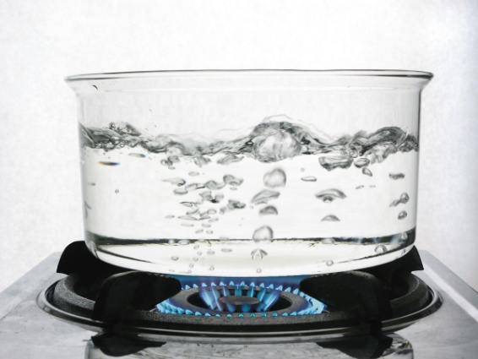
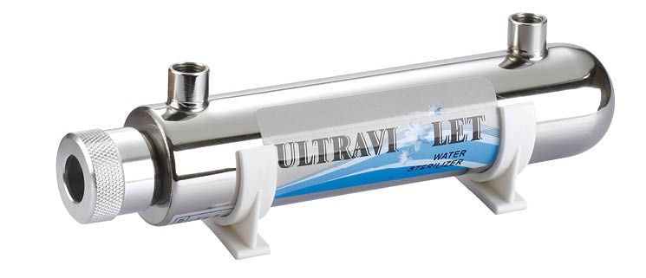
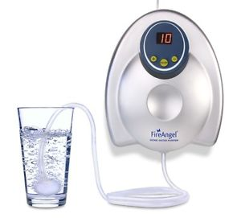
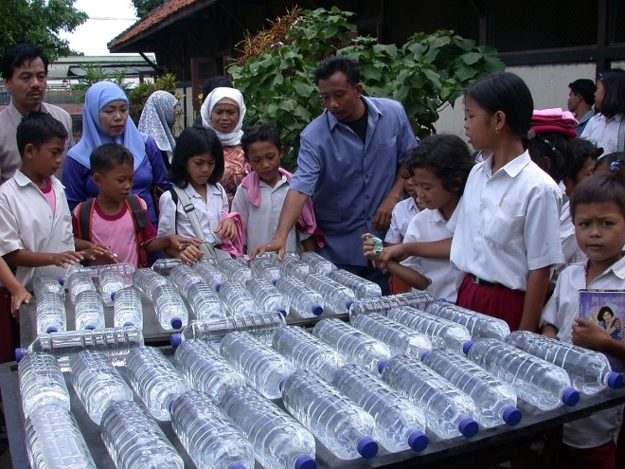
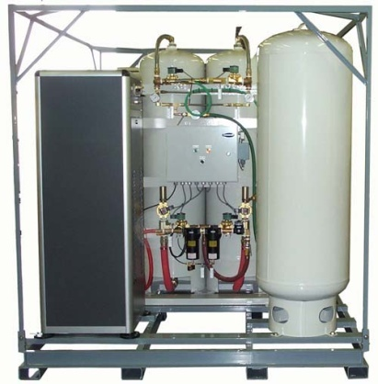
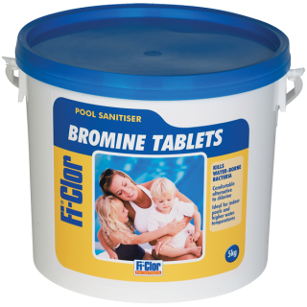
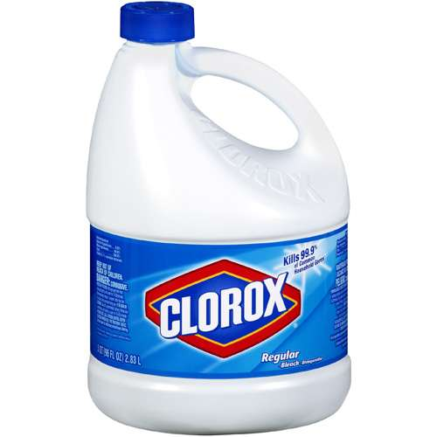
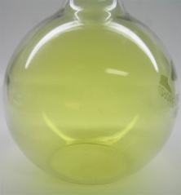
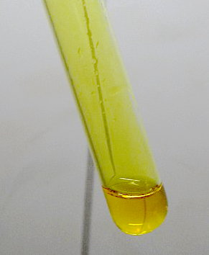
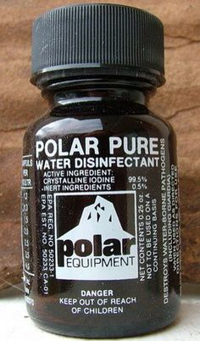
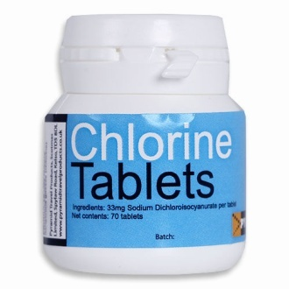
Lab 4: H₂O Purification & Conservation: Sterilization
Sterilization: Microfiltration can actually remove microbes from water, but it’s usually cheaper and faster to simply kill the microbes.
Boiling: We all know that boiling water will kill dangerous microbes. It’s a simple approach but requires a lot of energy and time.
Ultraviolet light: UV light has the energy to break bonds, which can kill microbes. Water is passed through a clear tube that’s illuminated with UV light. They have small ones for aquariums and household use, plus giant ones for city water treatment.
Solar disinfection of water: Another good source of UV light is sunlight. Sunlight also heats up water. So placing water in typical water bottles and placing them in the sun for about 5 hours will kill most microbes. Glass bottles will not work because glass absorbs too much UV light.
Ozone Generators
Ozone (O₃): Oxygen (O₂) exposed to high voltage or UV light splits into two single oxygen atoms, which then attach to oxygen molecules. O₂ -> O + O then O₂ + O → O₃
Ozone generators come in industrial sizes for city water treatment and small sizes for home use. Ozone is very reactive and attacks living things and organic (carbon-based) materials by attaching oxygen atoms to them. This is similar to what happens when things burn.
Chemical Disinfection: A variety of chemicals are used to disinfect water (kill microbes). One used around the house is sodium hypochlorite (NaClO), which is used in Purex and Clorox. Chlorine (Cl) is an halogen (column 17 in Periodic Table). Two other halogens are also used for disinfecting water (bromine and iodine). Chlorine gas (Cl₂) and chlorine dioxide (ClO₂) gas are bubbled through water to kill microbes. Hydrogen peroxide is another disinfectant. It’s also a bleach like many disinfectants. A different disinfectant are particles of silver.
Sodium hypochlorite
NaClO solution
Chlorine
Chlorine dioxide gas and solution
Iodine crystals
Notes:
"Indonesia-sodis-gross" by SODIS Eawag - Own work. Licensed under CC BY 3.0 via Commons - https://commons.wikimedia.org/wiki/File:Indonesia-sodis-gross.jpg#/media/File:Indonesia-sodis-gross.jpg For sunlight sterilization of water.

Slide 4
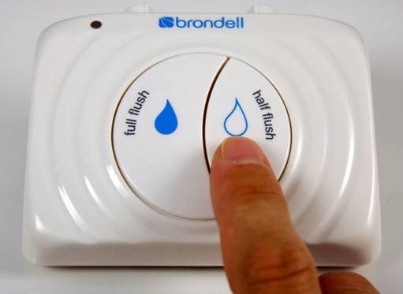
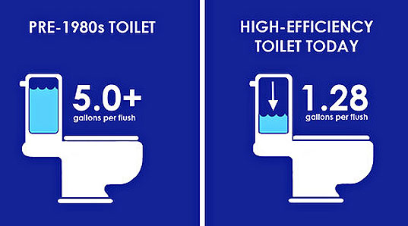
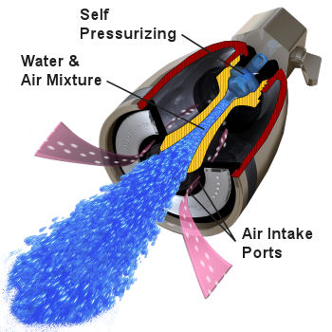
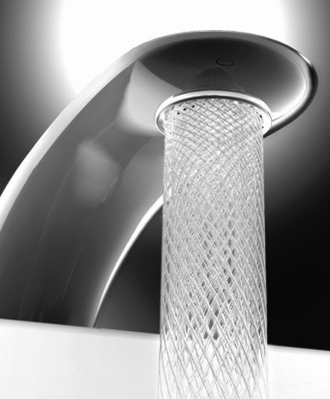
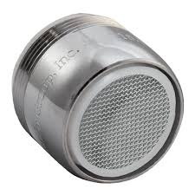
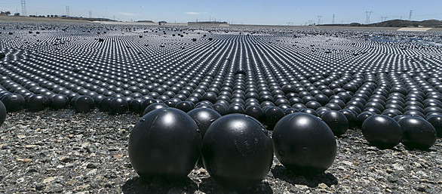
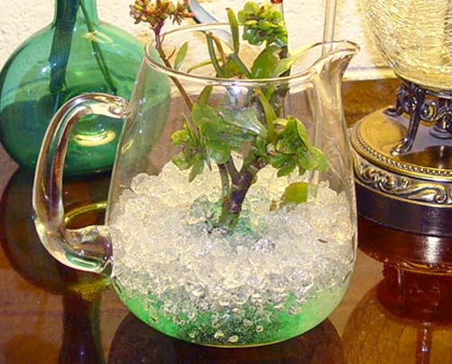
Lab 4: H₂O Purification & Conservation: Conservation
Water Conservation: There are many strategies for water conservation. Some strategies reduce the amount of water that shower heads, toilets, and washing machines use. Other strategies are aimed at reducing loss of water due to evaporation.
High Efficiency (HE) Appliances: The U.S. Department of Energy promoted laws that would conserve energy. One was to require manufactures of washing machines to be more water efficient. Since water is often heated, using less water also meant using less energy.
Water efficiency expanded to toilets. Some have dual flush.
Low flow faucets and shower heads: The EPA has promoted laws that set a limit of water flow of 2.5 gallons per minute for faucets and shower heads. To give a feeling or more water, designs that add air to water, pulsate water, or create uniform streams of water.
Aerator screen
Aerates and pulses
Creative streams
Evaporation prevention: One approach is to cover water to prevent evaporation. Another approach is to use natural and man-made substances that strongly absorb water so that the water doesn’t evaporate as easily or seep down out of reach.
Block evaporation: Thousands of black balls float on water in reservoirs to prevent evaporation & reduce contamination. White balls & floating solar panels are also used.
Drought resistant plants & smart irrigation: Water is also conserved by using plants that need less water. Xeriscaping is landscaping with plants that reduce or eliminate irrigation. Mesa Community College has a nice Xeriscape area. People need to learn not to overwater their lawns and plants and also not water during times of high evaporation (daytime or windy).
Super absorbent polymers: Sodium polyacrylate has the ability to absorb 200 to 300 times its mass in water. It’s used in diapers and also used as a soil substitute or a soil amendment to retain water.
Notes:
Federal regulations mandate that new showerhead flow rates can't exceed more than 2.5 gallons per minute (gpm) at a water pressure of 80 pounds per square inch (psi). New faucet flow rates can't exceed 2.5 gpm at 80 psi or 2.2 gpm at 60 psi. You can purchase some quality, low-flow fixtures for around $10 to $20 a piece and achieve water savings of 25%–60%
There are two basic types of low-flow showerheads: aerating and laminar-flow. Aerating showerheads mix air with water, forming a misty spray. Laminar-flow showerheads form individual streams of water. If you live in a humid climate, you might want to use a laminar-flow showerhead because it won't create as much steam and moisture as an aerating one.
Before 1992, some showerheads had flow rates of 5.5 gpm. Therefore, if you have fixtures that pre-date 1992, you might want to replace them if you're not sure of their flow rates. Here's a quick test to determine whether you should replace a showerhead:
The aerator -- the screw-on tip of the faucet -- ultimately determines the maximum flow rate of a faucet. Typically, new kitchen faucets come equipped with aerators that restrict flow rates to 2.2 gpm, while new bathroom faucets have ones that restrict flow rates from 1.5 to 0.5 gpm.

Slide 5
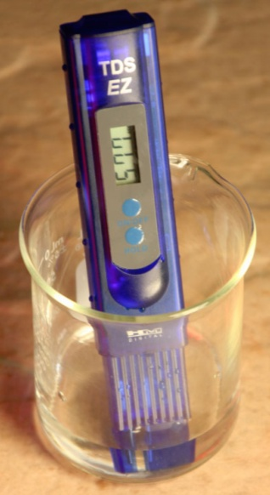
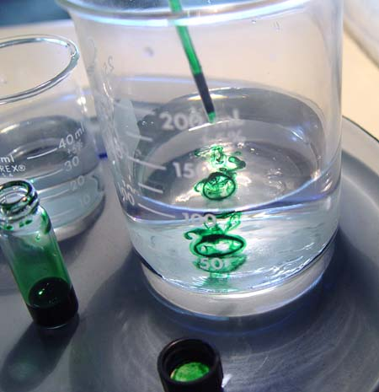
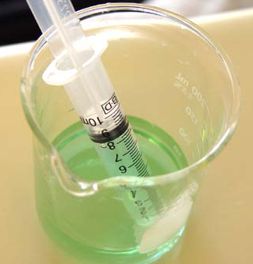
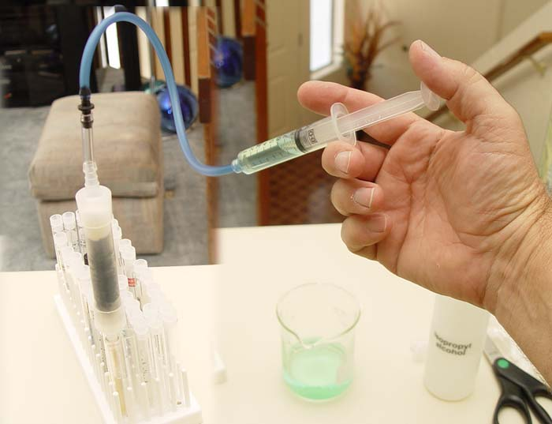
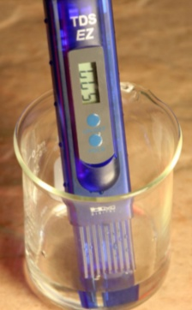
Lab4: H₂O Purification & Conservation: Combo-Filter
1. Combination filter: Assemble a filter according to the diagram on the left. It will trap organic (such as pesticides) and inorganic contaminants (such as toxic metal ions).
2. TDS Meter: Place 50 mL of the water sample into a 250 mL beaker. Use the TDS meter to test the total dissolved solids. The reading will include any toxic metal ions in the water.
_______ ppm=mg/L
3. Add dye: Use food coloring to represent large organic molecules. If your filter removes the dye color, that means it also removed organic compounds such as pesticides. So add one drop of food coloring to the 50 mL water sample.
4. Fill syringe: Fill the syringe with your sample water that has had the dye added.
5. Push water through filter: Attach the syringe to the blue tubing. Slowly push the water through the combination filter. Catch water in test tubes. Pour in beaker. Repeat steps 4 & 5 twice.
6. TDS Meter: Use the TDS meter again to test the total dissolved solids in your water sample after it’s been through the filter.
_______ ppm=mg/L
7. Questions: Did the dye color disappear after passing through the filter? ______ If not, was the color diminished? ________
What part of the filter affects the TDS value?
________________________________
What part of the filter traps the dye? _________________________________
Sterilization: Even after filtering, microbes can be present. 6 drops of household bleach will sterilize a
gallon of water. Or you can use
sunlight or UV light to sterilize
your filtered sample.
Notes:
http://water.epa.gov/drink/emerprep/emergencydisinfection.cfm If water is cloudy, let it settle and filter it through a clean cloth, paper towel, or coffee filter.
Disinfect water using household bleach,if you can’t boil water. Only use regular, unscented chlorine bleach products that are suitable for disinfection and sanitation as indicated on the label. Do not use scented, color safe, or bleaches with added cleaners. Locate a fresh liquid chlorine bleach or liquid chlorine bleach that is stored at room temperatures for less than one year. The label should say that it contains 8.25% of sodium hypochlorite. Use the table below as a guide to decide how much bleach you should add to the water, for example, add 6 drops of bleach to each gallon of water. Double the amount of bleach if the water is cloudy, colored, or very cold. Stir and let stand for 30 minutes. The water should have a slight chlorine odor. If it doesn’t, repeat the dosage and let stand for another 15 minutes before use.If the chlorine taste is too strong, pour the water from one clean container to another and let it stand for a few hours before use.

Slide 6
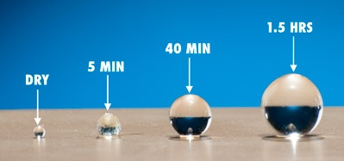
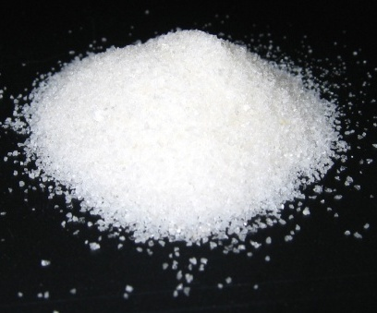
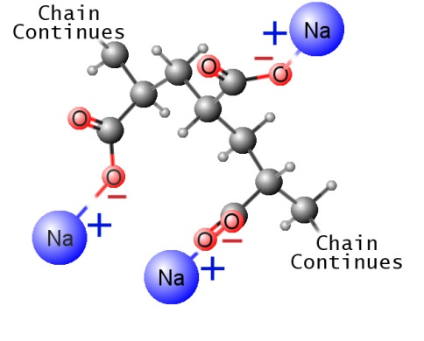
Lab 4: H₂O Purification & Conservation: Conservation
Sodium polyacrylate absorbing water
Sodium polyacrylate in crystal form
1. Sodium Polyacrylate: Sodium polyacrylate is a long chain polymer. In water, the positive sodium atoms (Na⁺) are pulled off by water leaving the negative (-) oxygen atoms exposed. Other water molecules are strongly attracted to these negative charges. In this way the polyacrylate chain soaks up water. Note: Sodium polyacrylate commonly comes in bead form and in large or small crystals.
2a. Volume & Mass Change due to water: Use digital caliper to measure diameter of three of the dry sodium polyacrylate beads. Diameters (mm): ________ ________ ________
2b. Divide the diameters by two to get radius of each bead: _______ _______ _______
2c. Find average radius of the dry beads (get total then divide by 3): _______
2d. Use portable or analytical balance to measure mass of all 3 dry beads: __________
Place the 3 spheres in warm tap water (or warm distilled water) to speed up absorption.
2e. Measure total mass of the 3 enlarged wet beads: __________ grams
2f. Divide mass of the 3 wet beads(2e) by the mass of the 3 dry beads(2d). ___________
This tells you how many times larger by Weight the beads get in water.
2g. Measure diameters of the enlarged wet beads (in mm): ________ ________ ________
2h. Divide the diameters by two to get radius of each wet bead: _______ _______ _______
2i. Find average radius of the 3 wet beads: _________
2j. Divide average radius of the 3 large wet beads(2i) by the average radius of the 3 dry beads(2c). _________ This tell you how many times larger by Scale the wet beads are.
2k. Use V=⁴/₃πr³ to get volume (cubic mm) of each dry bead then total up their volumes: _______ _______ _______ Total=_______ Show work on back.
2L. Use V=⁴/₃πr³ to get volume (cubic mm) of each wet bead then total up their volumes: _______ _______ _______ Total=_______ Show work on back.
2m. Divide average volume of wet beads by average volume of dry beads to see how many times larger by Volume the wet beads became. _____________
Note: Saying something is 10 times larger is incomplete. You have to ask, “Is it 10 times larger by weight, by scale, or by volume?”. These can differ by 1,000 fold.
Instructor will give you list of items to take home for more testing.
Notes:
http://water.epa.gov/drink/emerprep/emergencydisinfection.cfm If water is cloudy, let it settle and filter it through a clean cloth, paper towel, or coffee filter.
Disinfect water using household bleach,if you can’t boil water. Only use regular, unscented chlorine bleach products that are suitable for disinfection and sanitation as indicated on the label. Do not use scented, color safe, or bleaches with added cleaners. Locate a fresh liquid chlorine bleach or liquid chlorine bleach that is stored at room temperatures for less than one year. The label should say that it contains 8.25% of sodium hypochlorite. Use the table below as a guide to decide how much bleach you should add to the water, for example, add 6 drops of bleach to each gallon of water. Double the amount of bleach if the water is cloudy, colored, or very cold. Stir and let stand for 30 minutes. The water should have a slight chlorine odor. If it doesn’t, repeat the dosage and let stand for another 15 minutes before use.If the chlorine taste is too strong, pour the water from one clean container to another and let it stand for a few hours before use.

